Slide 1
NEGOTIATING A COMMERCIAL LEASE: An Insider’s Perspective
Rory S. Coakley
Coakley Realty
February 20, 2013
Sponsored by:

Slide 2
COMMERCIAL SPACE
Start a Business
Expand or Relocate an Existing Business
Space is Too Big or Too Small
Notes:
Reasons to look for commercial space:
Time to move out of the house
You may have been locked into a lease that does not work for you company
Due to a certain event in your business, you may need multiple locations
Due to technology or sales you just don’t need the amount of space you currently have.

Slide 3
COMMERCIAL SPACE
Office
Retail
Medical
Industrial
Notes:
Types of Commercial Space:
4 general categories

Slide 4
WHAT ARE YOUR REQUIREMENTS?
Square Footage
Preferred Location
Ceiling Heights
Loading Docks
Drive in Doors
Plumbing
Medical
Electrical
Industrial/Restaurant
Security
Government
Contractor
Notes:
WHAT SIZE SPACE DO YOU NEED?
HOW IMPORTANT IS LOCATION?
DO YOU NEED TO BE NEAR PUBLIC TRANSPORTATION?
DO YOU RECEIVE PACKAGES THERE? WOULD YOU REQUIRE LOADING DOCKS OR DRIVE-IN DOORS?
DO YOU HAVE SPECIAL MECHANICAL, PLUMBING OR ELECTRICAL REQUIREMENTS?
ARE YOU A GOVERNMENT CONRACTOR WITH LOCATION AND SECURITY ISSUES?

Slide 5
PREPARE A CRITICAL PATH
Search
Lease Negotiations
Design
Construction
Permitting
Moving
Timing – avoid paying double rent and/or holdover rents
Notes:
Relocating or moving into a new space is a very fluid process with many moving parts.
Be sure to allow time for the search, lease negotiations, design, construction, permitting and moving.
If you are currently in an existing lease you need to plan the exit of the existing space to coincide with the move to the new space.
Try to avoid paying double rent and/or holdover rents 2X.

Slide 6
SEARCH
Allow Time
Spend Time
Notes:
Depending on your requirements the right space may take - Days, Weeks or Months to find
THIS IS A VERY IMPORTANT COMPONENT FOR THE SUCCESS OF YOUR BUSINESS
PLAN TO SPEND TIME AND SPEND IT
IF YOU PUT IT OFF, YOU CAN HURT YOUR BUSINESS, LOSE A CONTACT OR EMPLOYEES OR PAY DOUBLE RENT

Slide 7
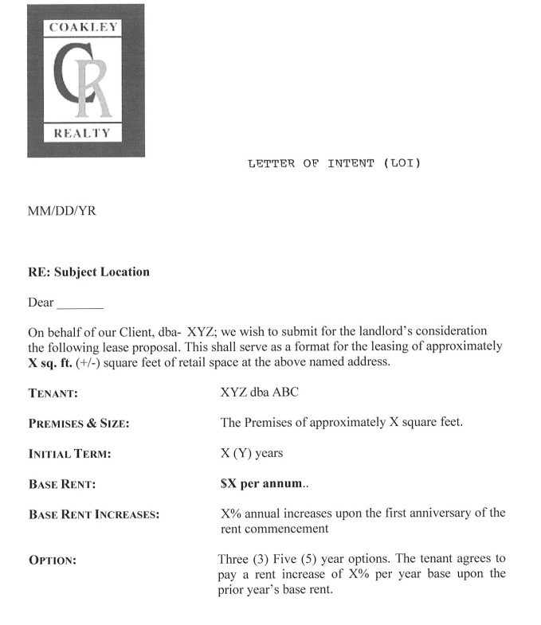
SELECTION
Obtain Letters of Intent (LOI)
Narrow Choices (3-4 if possible)
Prepare a Grid for a Comparative Analysis and Ease of Review
Notes:
- GO AND SEE THE SPACES
- NARROW YOUR CHOICES

Slide 8
COMPARATIVE ANALYSIS
 | Site A | Site B | Site C
SQUARE FEET | 3000 | 2500 | 3200
PRICE PER SQ | $25 | $27 | $31
ANNUAL BASE | $75,000 | $67,500 | $99,200
CEILING HEIGHT | 8’ | 9’ | 8.5’
LOADING DOCK | NO | NO | YES
DRIVE IN DOOR | NO | YES | NO
VISIBILITY | POOR | GOOD | EXCELLENT
SIGNAGE | NO | NO | YES
PARKING RATIO | 4/1000 | 3.5/1000 | 4/1000
AMENITIES | DELI | NONE | DELI
ADA COMPLAINT | YES | YES | YES
ELEVATOR | NO | YES | YES
ELECTRIC SERVICE | 200 AMP | 200 AMP | 200 AMP
LEASE TERM | 3-5 | 3 | 3-5
LANDLORD ALLOWANCE FOR T.I. | $20 PSF | 25PSF | 30 PSF
FULL SERVICE/NNN | NNN | F.S. | F.S.
CORE FACTOR | 10% | 13% | 9%
SECURITY | CARD | NONE | SIGN-IN
WEEKEND HVAC | SELF CONTAINED | $40 PER HOUR | $50 PER HOUR
COMMON AREA MAINTENANCE | $300ASF(AM) | INCLUDED | INCLUDED
PERSONAL GUARANTY | NO | YES | YES
LEASE DOCUMENT | MODERATE | COMPLEX | COMPLEX
DELIVERY DATE | IMMEDIATE | 2 MONTHS | 1 MONTH
Notes:
Here is a sample of a comparative analysis grid.

Slide 9
NEGOTIATION AND THE LEASE
Negotiate Business Terms
Contact a Real Estate Attorney
* RECOMMENDATION: use a Real Estate Attorney who regularly reviews commercial leases. This is a contract and you are locked in for the full term.
Notes:
A SINGLE WORD OR CLAUSE IN A LEASE CAN BE VERY EXPENSIVE & RESTRICTIVE

Slide 10
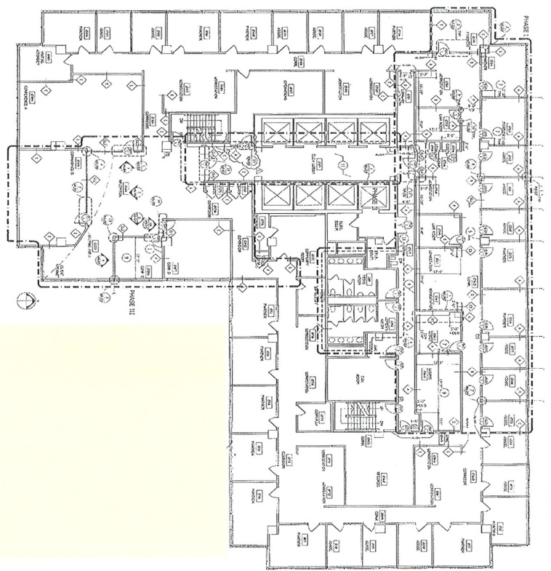
SPACE PLAN
Professional Space Planner
Architect
Some Landlords Provide These Services, but you may have to hire your own
Biotech, Restaurant or Medical often require a specialty designer to meet specifications
Notes:
Depending on the size and complexity of the space and the necessary tenant improvements, the landlord may provide the services of a professional space planner or architect to prepare a space plan.
It may take a few drafts or test fits to adequately plan your space.
You may have to hire your own specialty designer for unique spaces such as biotech, restaurant or medical.

Slide 11
CONSTRUCTION DOCUMENTS – “BLUEPRINTS”
Blueprints Include Detailed Specifications Containing Separate Sections for Mechanical, Plumbing, Electrical and Structural Features
Blueprints May Take Weeks or Months to Prepare
Notes:
Once the space plan is complete the architect will prepare a detailed set of construction documents and specifications.
These documents may take weeks or months to prepare.
They are extremely detailed and include separate sections for mechanical, plumbing, electrical and structural.

Slide 12
GOVERNMENT APPROVAL
Construction Documents and Specifications Must be Submitted
Changes May be Required
Permitting Time
Notes:
Once the construction documents and specifications are complete they must be submitted to the local jurisdiction’s permitting department for review and approval.
Invariably, the government review agencies will require changes in the drawings, particularly in the areas of fire protection and life safety.
Permitting can take anywhere from a few weeks to 4-6 months.

Slide 13
CONSTRUCTION BID AND CONTRACTOR SELECTION
Contractors are Selected for the Bid
Bidding Process
Comparative Analysis Grid
Notes:
While the documents are in for permit review, it is time to get competitive construction bids.
Typically 2 or more general contractors are invited to bid on the project.
General Contractors are selected for reputation, expertise in construction type, availability, etc.
You may have a specific deadline to meet so you don’t end up paying rent on two spaces.
The bidding process can take a few weeks or even months depending on the scope of work.
Once the bids are complete a comparative analysis similar to the Letter of Intent should be completed.

Slide 14
CONTRACTOR SELECTION
Meet with the Contractor
Personnel
Overhead and Profit
The Schedule
Subcontractors
Notes:
Once you decide on the first choice you can meet with the contractor and discuss the details of the bid, the personnel the propose to manage the job, the overhead and profit, the schedule and the subcontractors they propose to use.

Slide 15
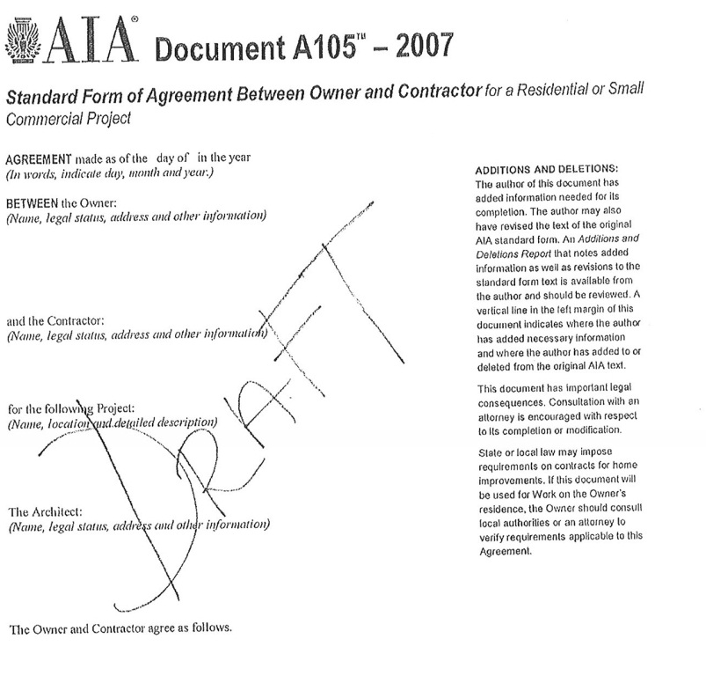
CONSTRUCTION CONTRACT
Standard AIA Form or Custom Contract
* Recommendation: Have the Contract Reviewed by a Lawyer with Experience in Construction Contracts
Notes:
Once the have agreed to the business terms of the bid the contractor will present a construction contract in a standard AIA form or they’re own custom contract. (Aia) AMERICAN INSTITUTE OF ARCHITECTS.
Again, just like the lease it is highly recommended to obtain the services of a lawyer who regularly reviews construction contracts.
This may not be the same lawyer that reviewed your lease.
There are numerous concealed conditions and surprises that can surface during any construction project.
The terms and conditions of the contract will govern most of these items.

Slide 16
CONSTRUCTION
Once Government Approvals and Permits are Obtained
Schedule
* Recommendation: Hire a Consultant to Oversee the Contractors Work and Their Adherence to Plans and Specifications.
Notes:
Once the government approvals and permits are obtained you can begin construction.
Again, depending on the scope of work, the project may take weeks or months.
It is recommended that you hire a consultant who can check the contractors work and the adherence to the plans and specifications.
This person could be who designed the space or better yet and independent third party who has no dog in the fight.
It is common place for designers and contractors to dispute the scope of the work.

Slide 17
PUNCH LIST
Substantial Completion
The Last Draw
Notes:
After the project is substantially complete it is customer to prepare a “Punch List” of incomplete work, missing items, and/or defective work.
The contractor’s last draw payment is typically not paid until the punch list is 100% complete.

Slide 18
THE MOVE
Requires Careful Planning and Coordination to Minimize Downtime and Avoid Major Glitches
Notes:
This is the final piece of the puzzle which requires careful planning and coordination to avoid major glitches and downtime with computers, servers, phone service, etc.
Coakley Realty just moved last month and w enlisted the services of a moving coordinator who planned and executed the move.
Additionally, they handled the competitively bid on new phone systems, systems furniture, cabling contractors, and movers.
Prior to the move they met with my staff and informed them about the logistics of the move.
On moving day they were on site coordinating all of the vendors and assisting my staff.
The process went very smoothly and it was well worth the investment.

Slide 19
Sound Complicated??
Are you ready to ‘Go it Alone’
Commercial Leasing Agent
Information
Contracts
Negotiations

Slide 20
Q & A

Slide 21
NEGOTIATING A COMMERCIAL LEASE: An Insider’s Perspective
Thank You For Attending
Sponsored by:

